Slide 1
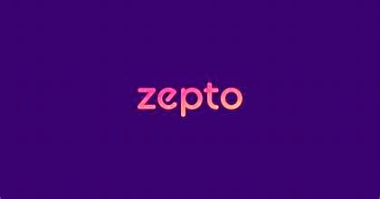
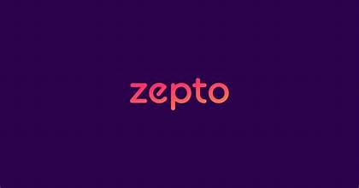
INTRODUCTION TO ZEPTO (DELIVERY)
Zepto is a trailblazing Indian startup that has redefined the grocery delivery landscape with its astonishingly rapid service. This innovative company has captured the imagination of consumers and investors alike by offering to deliver groceries to customers' doorsteps in an incredible 10 minutes or less.

Slide 2
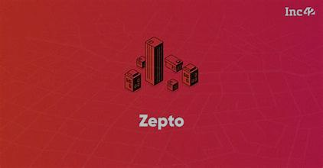

Zepto Founders: Aadit Palicha and Kaivalya Vohra
Zepto was co-founded by two young entrepreneurs, Aadit Palicha and Kaivalya Vohra.Both were college dropouts who saw an opportunity in the burgeoning online grocery delivery market. Their vision of delivering groceries within minutes has transformed the industry

Slide 3
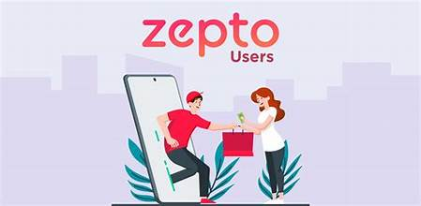
Zepto's Mission
Zepto's mission is to make 10-minute delivery the new normal.
The company is focused on revolutionizing the grocery delivery industry by providing unparalleled speed and convenience to customers. By offering a vast array of products delivered to your doorstep within a matter of minutes, Zepto aims to redefine the way people shop for groceries.
Zepto's Business Model: Speed and Convenience
Zepto's business model revolves around providing an ultra-fast grocery delivery service. They have disrupted the traditional grocery shopping experience by offering a wide range of products delivered to customers' doorsteps within a matter of minutes

Slide 4
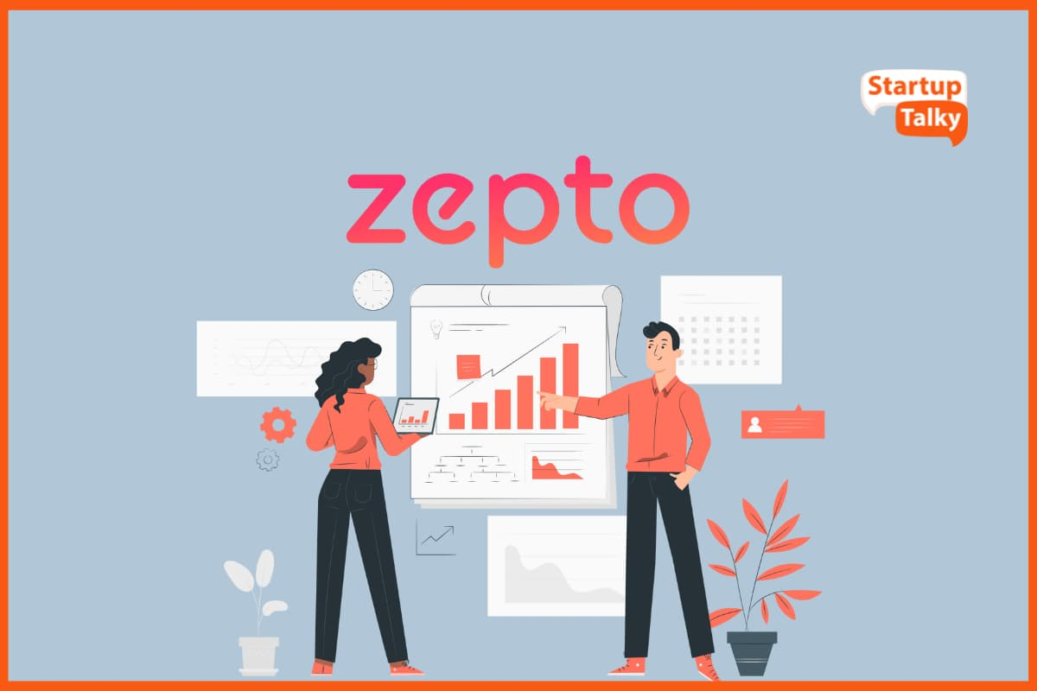
.
Key Components of Zepto's Business Model:
Dark Stores: Zepto operates a network of small, strategically located warehouses or "dark stores" that stock a limited but carefully curated selection of products. These stores are designed to optimize order fulfillment and delivery times.
Technology: Advanced technology plays a crucial role in Zepto's operations. From inventory management and order processing to route optimization and delivery management, technology is the backbone of their business.
Rapid Delivery: The core value proposition is speed. Zepto aims to deliver orders within 10 minutes, setting a new benchmark for the industry.
Customer Experience: Zepto focuses on providing a seamless and convenient shopping experience through its user-friendly app and efficient delivery process.
Revenue Model: Zepto primarily generates revenue through commission fees charged to partner stores and brands.
In essence, Zepto's business model is built on speed, technology, and customer satisfaction.

Slide 5
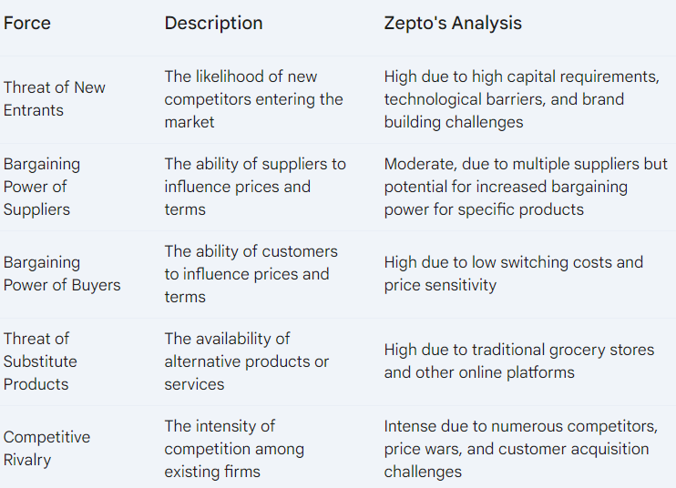
Porter's Five Forces Analysis for Zepto

Slide 6
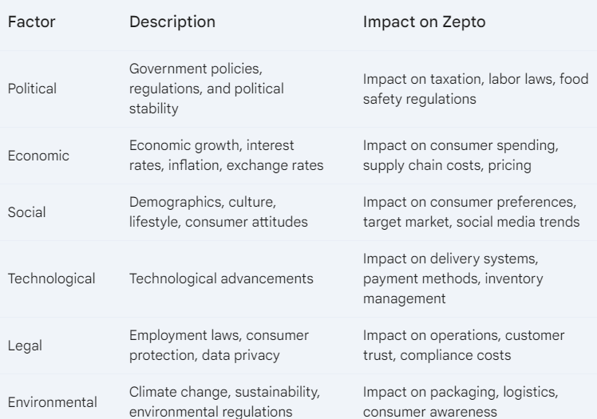
PESTLE Analysis for Zepto
Slide Content: A table or matrix visually representing the six PESTLE factors.

Slide 7
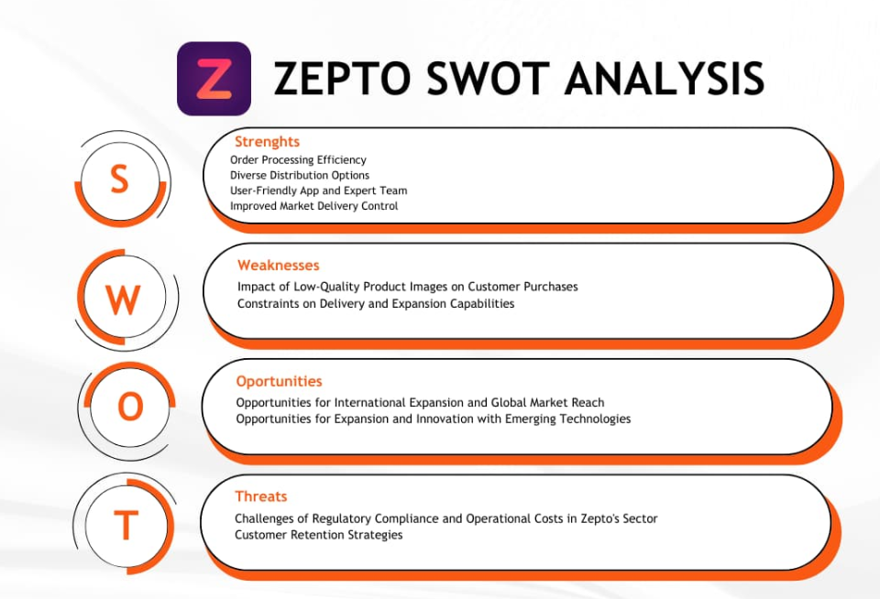

Slide 8
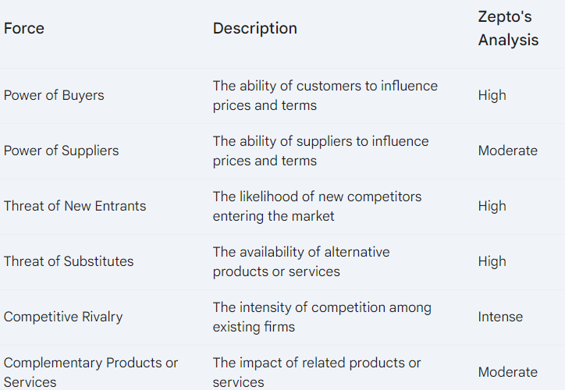
Slide Title: Six Forces Model - Zepto

Slide 9

The 3 Ps for Zepto: Product, Price, and Place
Product
Core product: Rapid delivery of groceries and essential items.
Actual product: Wide range of products, user-friendly app, efficient delivery process.
Augmented product: Additional services like order tracking, easy returns, and customer support.
Price
Competitive pricing: Zepto needs to offer competitive prices to attract customers and retain them.
Value-based pricing: While focusing on competitive pricing, Zepto should also consider the value it provides to customers through speed and convenience.
Promotional pricing: Offering discounts, promotions, and loyalty programs can be effective in attracting new customers and retaining existing ones.
Place
Distribution channels: Zepto's primary distribution channel is through its mobile app and dark stores.
Location strategy: The strategic placement of dark stores is crucial for efficient delivery.
Inventory management: Effective inventory management ensures product availability and minimizes stockouts.

Slide 10
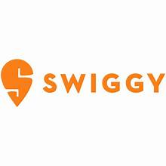

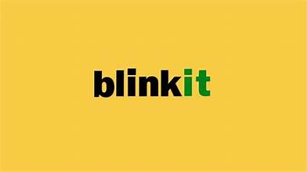

Zepto - Competitors
Many businesses compete with Zepto and have already been driving fast-paced delivery of groceries like:
Swiggy instamart
Big Basket
Blinkit
Dunzo

Slide 11

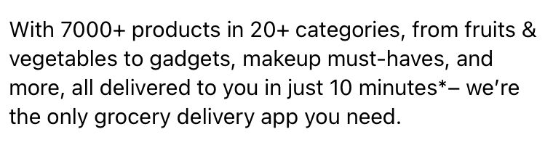
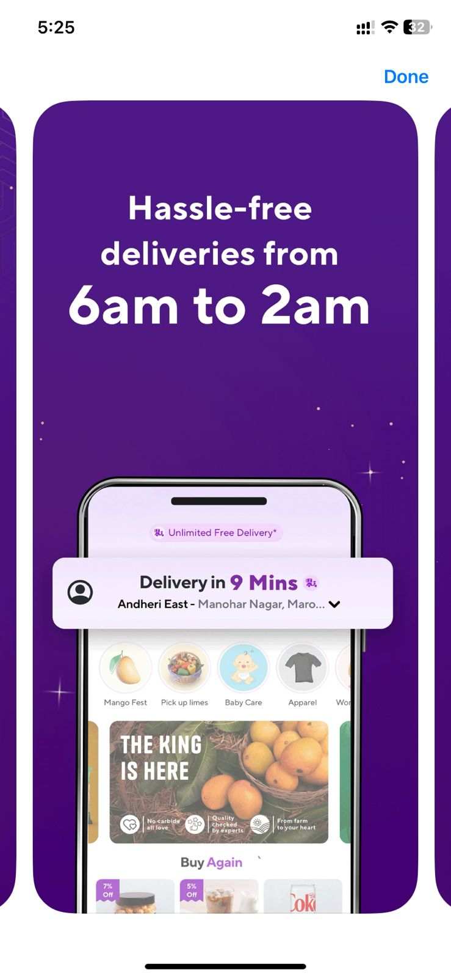
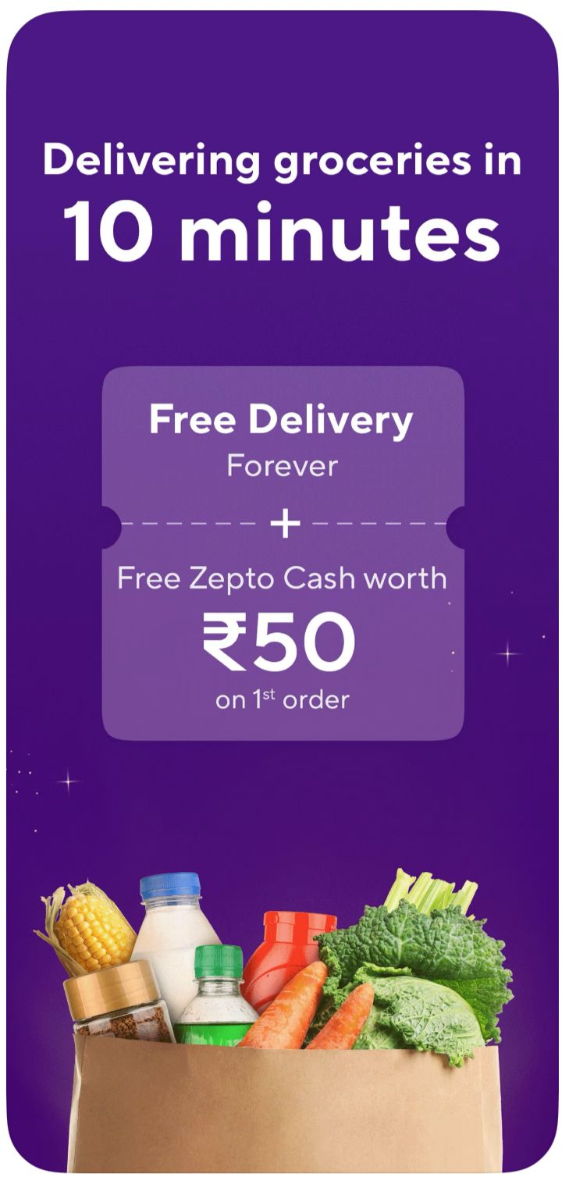
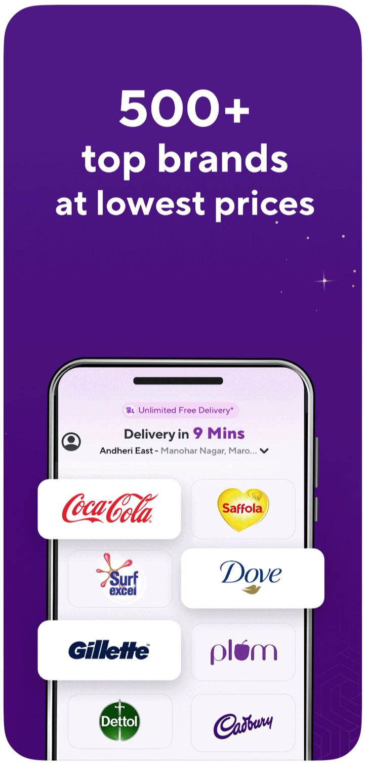
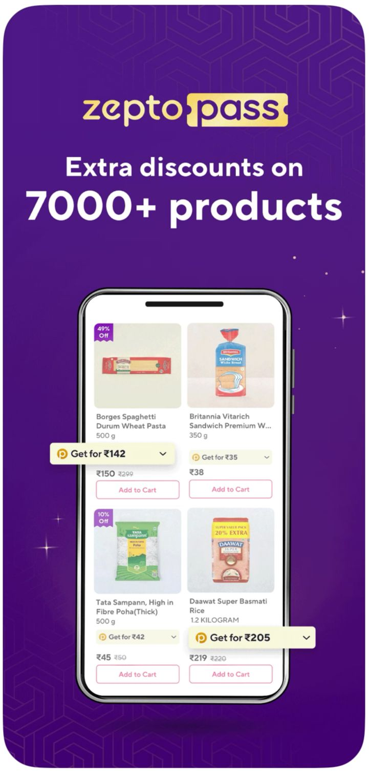

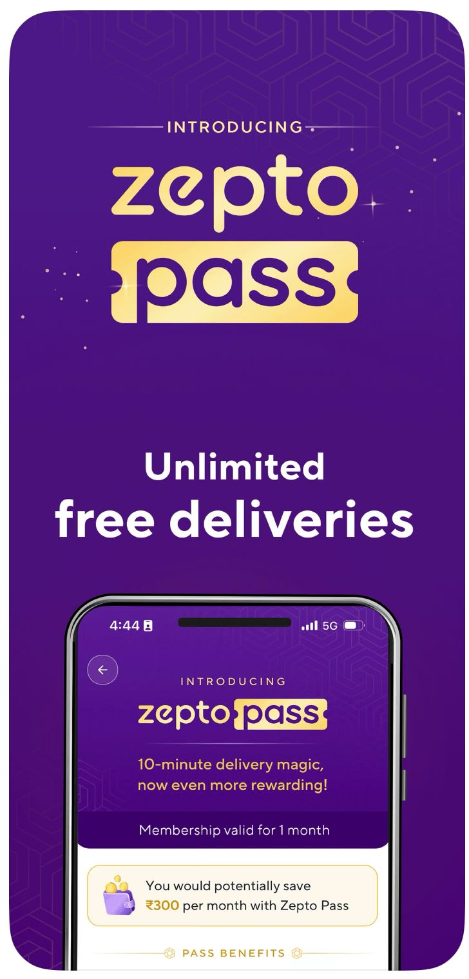
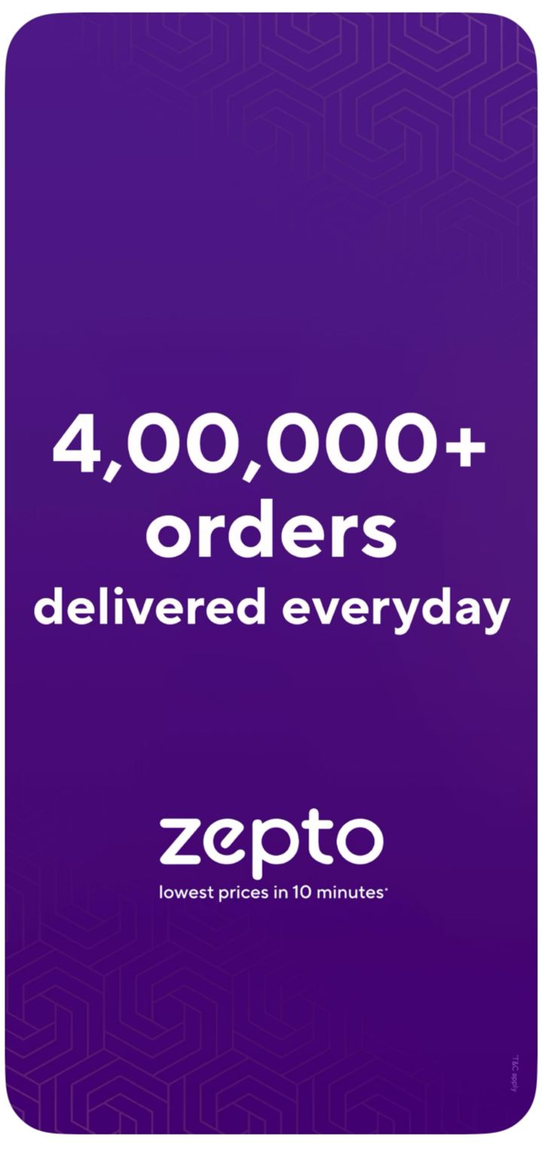

Slide 12
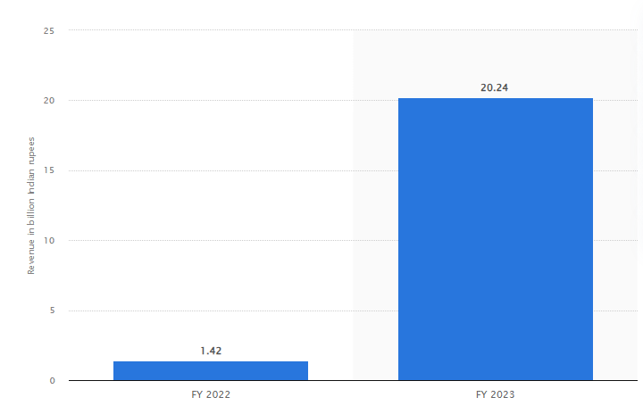
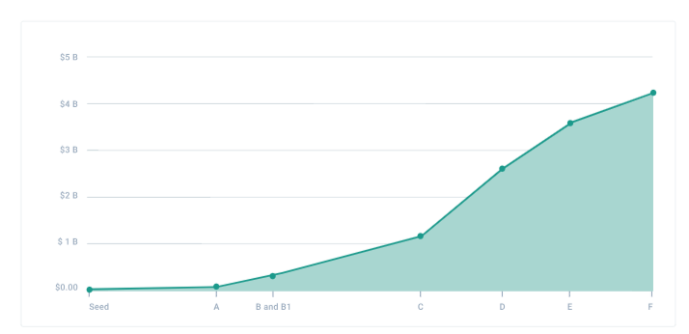
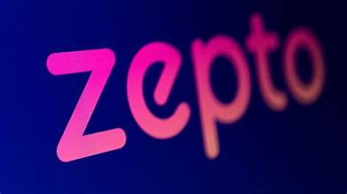
Revenue from operation of Zepto for financial year 2022 and 2023 Is financial year 2023, the operating revenue of quick commerce start-up Zepto amounted to over 20 billion Indian rupees. Zepto delivers groceries, personal care, electronics, and other consumer goods products within ten minutes.

Slide 13
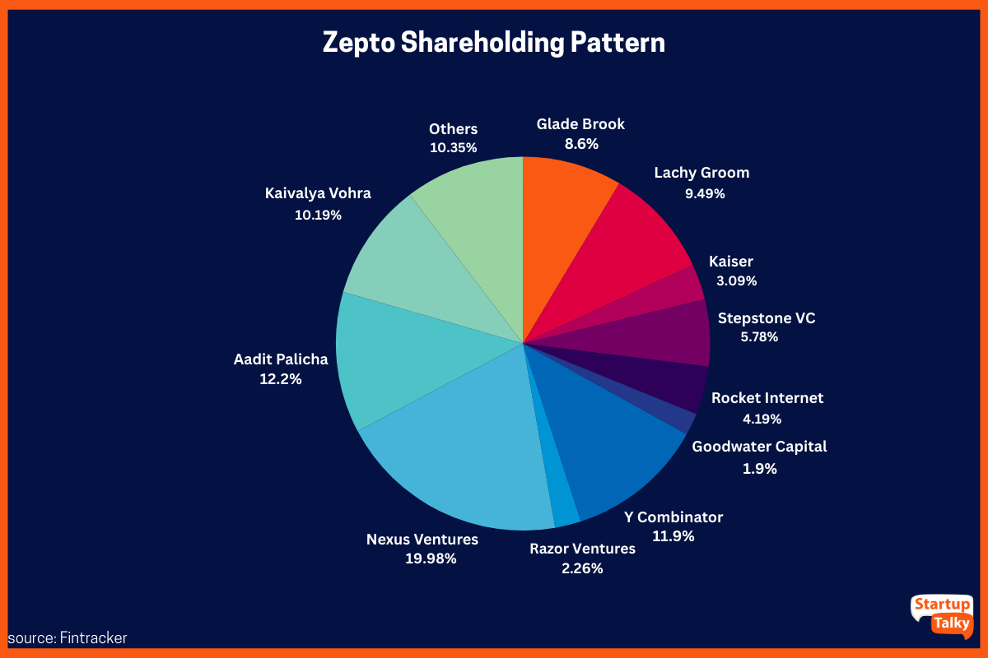
Among the shareholders, Nexus Ventures holds the largest stake, holding 20.9% of Zepto. Other prominent owners of Zepto include Y Combinator, Lacy Groom, Glade Brook, and co-founders Aadit Palicha and Kaivalya Vohra, among others.

Slide 14

DONE BY :
PRASANNAKUMAR .D
MBE9 batch
calvingameing10@gmail.com

